Slide 1
common food cuisines in Canada (Toronto )and USA (New York City)

Slide 2
Common Cuisine
To check the common food cuisines between Toronto, Canada and New York City, USA.
We will explore the NY and Toronto dataset to see
How does the types of cuisines in Toronto and New York vary?
Which Cuisines are popular in Toronto and New York?
Trying to find answers to above mentioned question in the Jupiter notebook.
Target audience will be one who has recently shifted in this city OR Existing locality who can get benefit to explore more cuisines in neighborhood

Slide 3
Data Collection
New York Location Dataset will be collected from web (NYU Spatial Data Repository link) which is available in Json format. In Python it will be converted to CSV format.
Notebook link to explore NY & Toronto Dataset
Toronto Location Dataset Like NY location dataset Toronto dataset will be build with same columns. Link to Dataset link

Slide 4
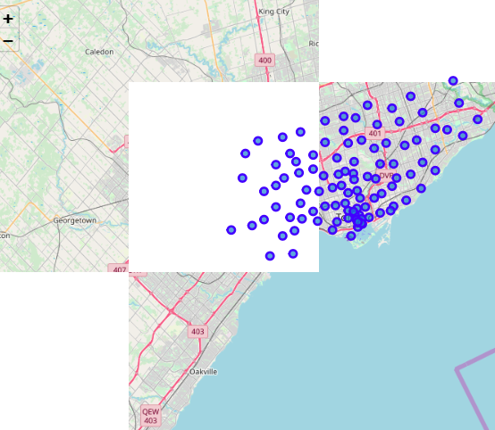
Neighborhoods of Toronto
Neighborhoods of Toronto can be seen in this map.

Slide 5
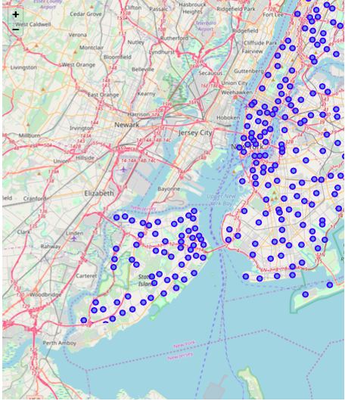
Neighborhood's of New York
Neighborhoods of New York can be seen in this map.

Slide 6
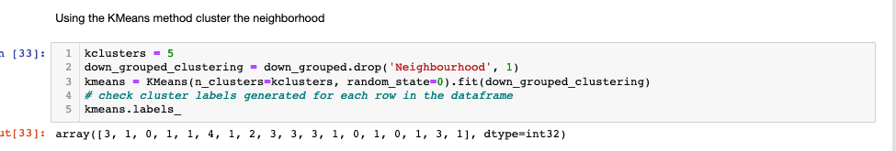
K Means Model cluster Neighborhood (Toronto Data set)

Slide 7
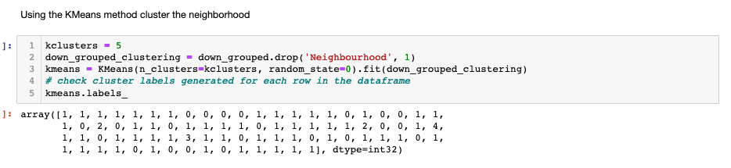
Display cluster Neighborhood on MAP (New York Data set)

Slide 8
Conclusion
Notebook link to explore NY & Toronto Dataset.
To conclude compared Downtown Toronto and New York restaurants from data frame.
In graph we can see just the 1st Most Common and so on. count plot from Seaborn package is used to visualize results.
From the graphs it is clear that Thai Restaurant is 1st Most Common Restaurant in Downtown Toronto Area. However, we can also see another value named just ‘Restaurant’. This can be considered as an inconsistency as we don’t know what kind of food that restaurant serves. We can assume that this restaurant serves majority of cuisines. In the similar way visualizations are generated for Toronto Data.
Most Common Restaurants in Queens NY
We can see that Restaurant, likewise if Toronto graph this can be considered as an inconsistency as we don’t know what kind of food that restaurant serves. We can assume that this restaurant serves majority of cuisines. Vietnam and Italian Restaurants lead the 1st Most Common Restaurants in Queens NY.

